Slide 1
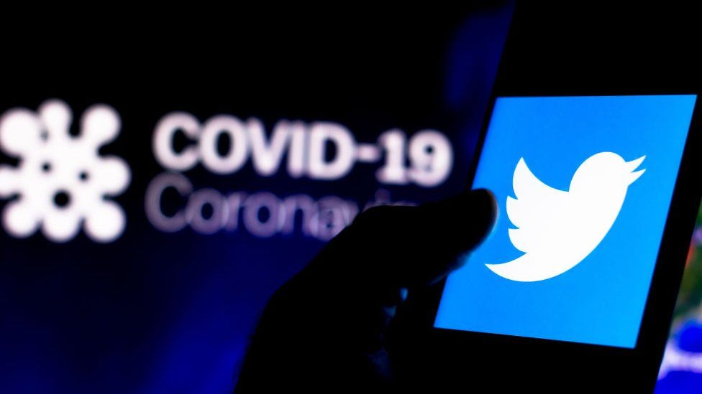
Covid-19 Impact on Twitter in North Carolina
University of North Carolina at Charlotte:
Data Analytics Bootcamp
Project Team: Jimmy White, Lauren Parrish, Mariam Ahmad, Zehra Tokatli, Hector Ladero

Slide 2
The project was designed to assess the impact of Covid-19 on Twitter usage in the state of North Carolina. The team hypothesized that Covid-19 references on Twitter are positively correlated to virus progression. A global baseline was established for early pandemic data and then compared to early North Carolina Covid-19 progression and Twitter activity.
Motivations & Summary:
Questions & Analysis:
Are Covid-19 references on Twitter linked to virus progression both globally and in North Carolina?
Early pandemic global references to Covid-19 on Twitter fluctuated and increases were linked to major headline days.
TBD – Twitter Data Mar – May Jimmy to populate
Does location impact the probability of Twitter use as the virus progressed?
TBD – Zehra to populate
As the number of cases and deaths increased, did Twitter original Tweets increase?
Early pandemic increases in original tweets were linked to headlines, but there was a slow increase regular original Tweets as the virus progressed into late February.
TBD – North Carolina Data set – Jimmy
As the number of cases and deaths increased, did Twitter retweets and likes increase?
Yes, as the virus progressed original Tweets did receive a growing number of retweets and likes.
TBD – North Carolina Data set – Jimmy
Is North Carolina a good representation of US COVID-19 trends and what thereby can be inferred about Twitter usage?
TBD – North Carolina Data set – Jimmy/Hector/Zehra to populate

Slide 3
Questions & Data:
1) Data from the Twitter API
2) Data tracking Covid-19 Progression
3) Geolocation Data from Google
Data from Twitter was the greatest challenge. Data in the public domain was either applied a cost, was too large, did not provide enough data, or was split into daily data dumps. To capture the data required for the project, a Twitter data scraper was built to retrieve North Carolina data and a Kaggle dataset was used for early global analysis.
Covid-19 data was pulled from two Kaggle data sets. One from the WHO which tracked early Covid cases globally and the second from the New York Times which broke cases down by state and county.
The Google Geolocation API was leveraged to identify Tweet and Covid case hot spots.

Slide 4
Significant time was spent locating Twitter data. Twitter requires paid use of its API to source portions of the data we wanted for our original assessment. Even with the limit of data that could be pulled, each month, day, even hour would churn so many tweets about Covid once the pandemic progressed that there was not sufficient time to download the information. A data scraper was created to limit the data pulled back from the API.
Data Clean-Up & Exploration:
Exploration Process:
Input Sample of Jimmy’s Twitter API Code

Slide 5
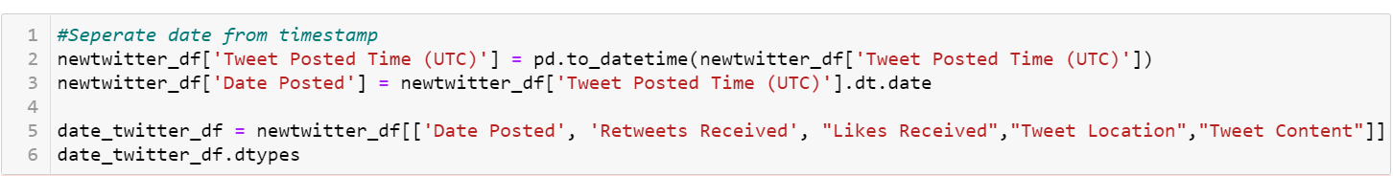
Covid-19 data and early Twitter data presented less of an issue, but there were still a few challenges. The both data sources used timestamps next to the date which required removal. Additionally, months required grouping to ease charting and analysis.
Data Clean-Up & Exploration (cont.):
Twitter’s unpaid offering did not provide geocoordinates. To use Google Geomaps the Twitter location data which required significant cleaning. People weren’t really tweeting from Pluto!
Input Sample of Zehra’s Geolocation Code

Slide 6
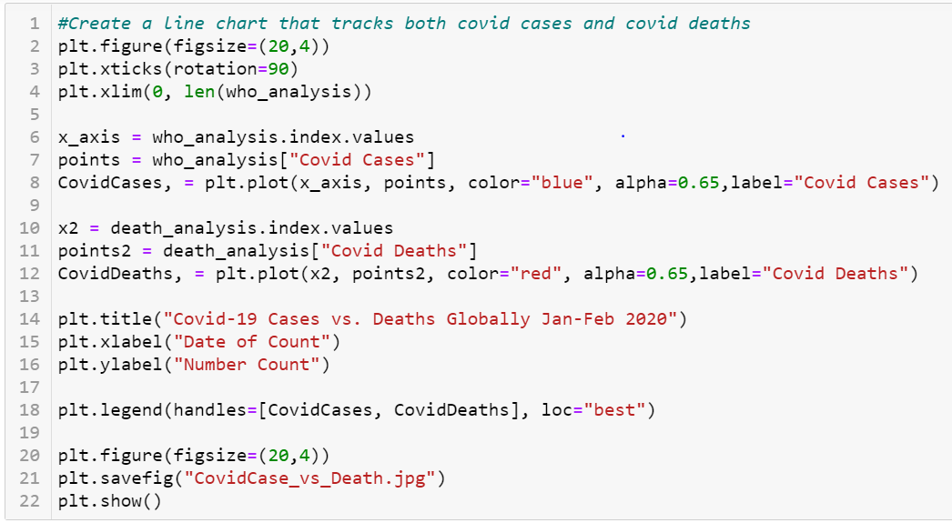
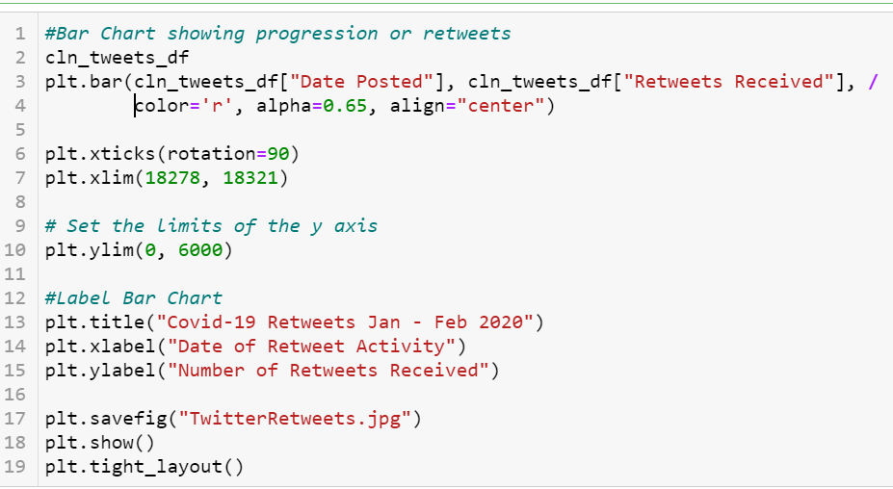
When analyzing the early global Covid data set versus the Twitter results, the first step was to determine which method would most clearly show any trends in Twitter data. This ended up being the bar chart as usage spikes were exceptionally clear. Then we had to decide how best to overlay the Covid-19 data to reflect that virus progression was not the main contributor to increases in Twitter usage. This was a line chart.
Data Analysis:
Early Global Covid-19 Progression vs. Twitter:

Slide 7
The scope of NC Covid-19 during the March 2020 – May 2020 was significant. As a result, the team narrowed it to Mecklenburg, Wake, and Buncombe as these represented largest population centers.
Data Analysis (cont.):
Covid-19 Rise in North Carolina vs. Twitter Geocoding:
Input Analysis – Zehra

Slide 8
Input Analysis - Jimmy
Data Analysis (cont.):
North Carolina Twitter Data vs. Covid-19 Progression:

Slide 9
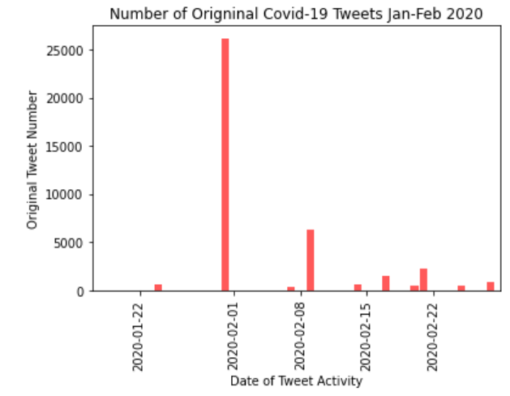
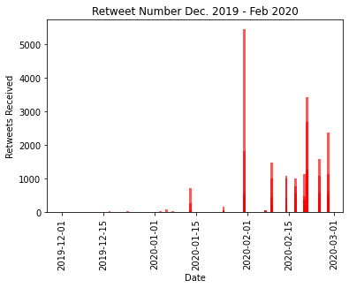
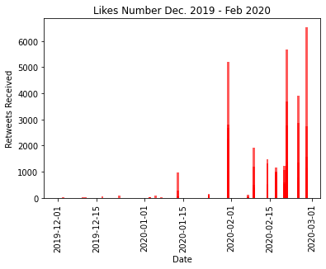
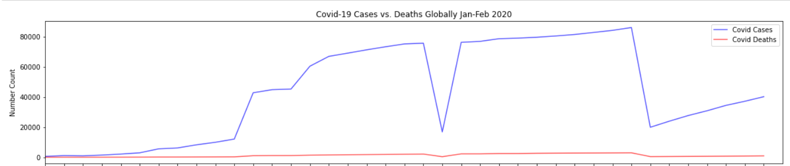
Discussion: Twitter Activity vs. Covid-19 Progression: Global Analysis

Slide 10
Discussion (cont.): Twitter Activity vs. Covid-19 Progression: Global Analysis
Observations:
During the early stages of the pandemic, Twitter data globally did not see a steady increase in original tweets as expected. Instead, higher numbers of original tweets occurred on days when there was major world headlines. Clear examples occurred on January 31st when the US announced travel restrictions for visitors returning from China and when the first quarantines were initiated. Similar headline grabbing announcements occurred on February 9th, 2020 (China investing10bn to fight the virus) and on February 21st (WHO announced that Covid-19 was officially a pandemic).
News cycles have significant impact on original tweets rather than sustained but increasing information such as what was experienced in the early part of the Covid-19 pandemic.
2) “Likes” and “Retweets” differed slightly. There were still peaks on days which correlated to major headlines, but as the virus progressed, “Likes” and “Retweets” reflected more stable forward progression as expected. Also, the comparison between “Likes” and “Retweets” reflects that Twitter users are more inclined to like rather than retweet.
As awareness of a topic, like Covid-19, grows, Twitter users are more likely to be involved in that topic. This corresponds to more tweet “Likes” and “Retweets.”

Slide 11
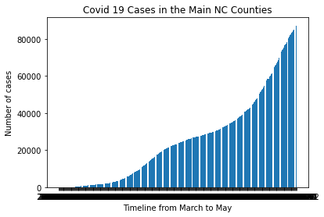
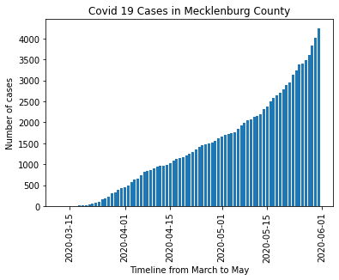
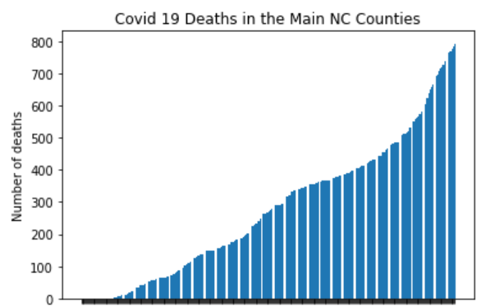
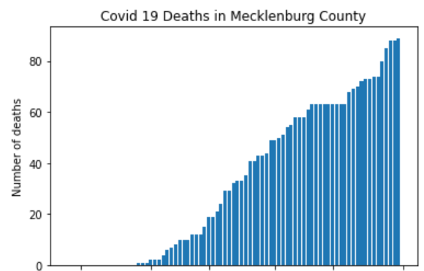
Discussion (cont.): Covid-19 Rise in North Carolina vs. Twitter Geocoding
Geolocation graphs – input Zehra

Slide 12
Discussion (cont.): Covid-19 Rise in North Carolina vs. Twitter Geocoding
Observations:
The data reflected that Mecklenburg County’s Covid-19 cases maintained a similar distribution to other North Carolina Metropolitan areas, however, they experienced a sharper increase in death rates. This corresponded to tweets…… Input from Zehra/Hector

Slide 13
Discussion (cont.): North Carolina Twitter Data vs. Covid-19 Progression
Input from Jimmy

Slide 14
Discussion (cont.): North Carolina Twitter Data vs. Covid-19 Progression
Observations:
Input from Jimmy

Slide 15
Postmortem:
Challenges:
Scope: Initially, the team wanted to pull in multiple social media providers to assess if Covid-19 increased usage of social media. Additionally, the team wanted to use a year’s worth of pre-Covid social media use as a baseline and a year’s worth of Covid-19 social media use. It quickly became apparent that this was too large a data set.
Data Retrieval: The team struggled to retrieve a sufficient data set from a social media provider. Some of the data we wanted to leverage, such as geolocations, required paid for services. This required the team to look for alternative data points. Often these data points required significantly more cleaning. Additionally, the social media providers had several restrictions due to data privacy as to what could and could not be used.
Deeper Dive:
1. If we compared Twitter to another social media provider, would our findings be consistent?
Is there a difference in the political slant of a headline and where in US we would see a greater uptick in tweeting activity?
Is Covid fatigue now having an impact on tweeting activity?

Slide 16
QUESTIONS?

Slide 17
Appendix – Additional Graphical Representations of Data

Slide 18
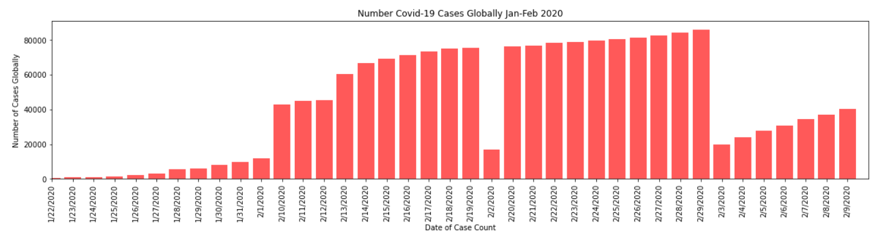
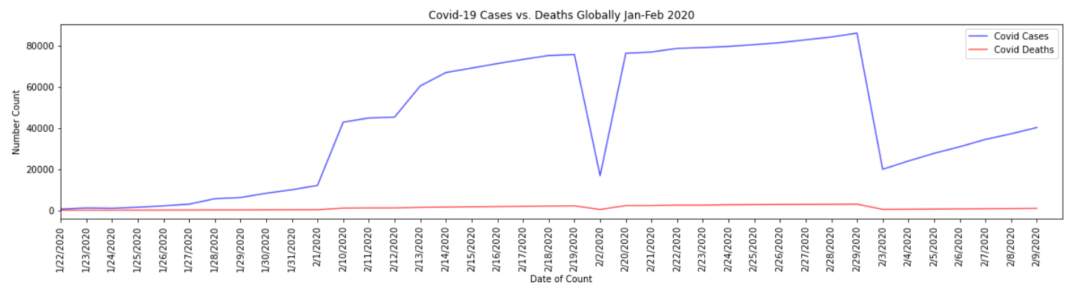
Global Progression in Covid-19 Cases

Slide 19
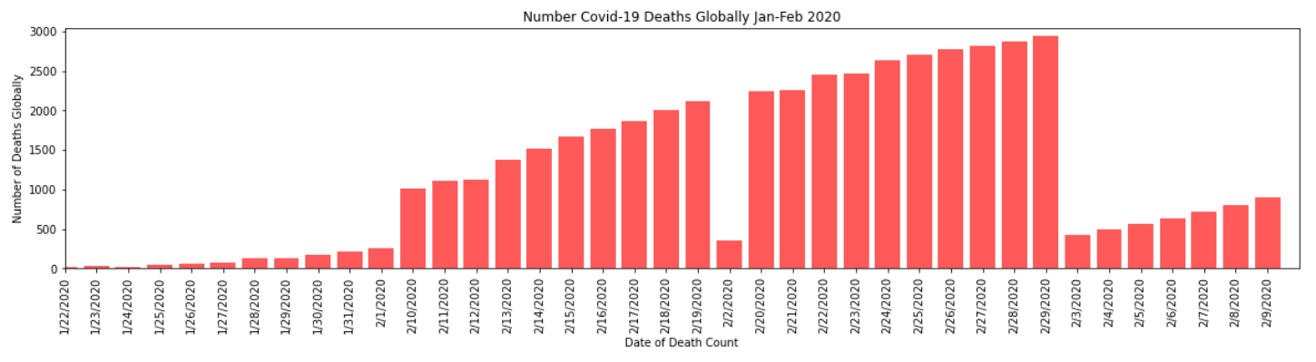
Global Progression in Covid-19 Deaths

